Slide 1

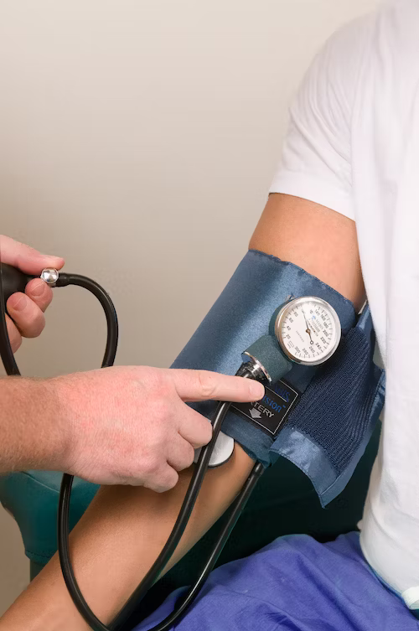
HEART DISEASE CLASSIFICATION
(Members)
1.Anawat Pradabsuk 124039 (Leader)
2.Ritik Sareen 123844
3.Tanzil Al Sabah 123845
4.Chatpol Phongyen 123992
5.Munthitra Thadthapong 124022
6.Md Shafi Ud Doula 124047

Slide 2



CONTENT
Introduction
Related Industry
Problem
Solution
Rationale
Mockups
Diagrams
Evaluation

Slide 3



INTRODUCTION
Background
Motivation
Cardiovascular diseases cause of death worldwide 17.9 M.
Diagnosis tools have limitation (costly)
The potential of machine learning for heart disease detection is immense.
The goal: early detection, timely interventions, and a significant reduction in the global impact

Slide 4
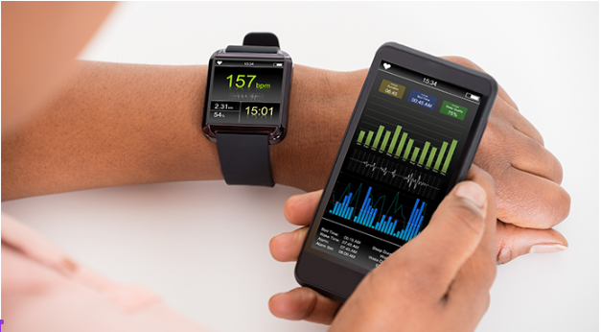
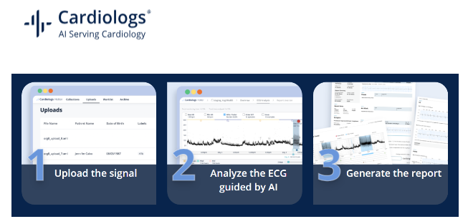
RELATED INDUSTRY
Health Monitoring Wearables can notify users of irregular heart rhythms.
Offers an ECG analysis platform powered by AI to detect arrhythmias and other conditions.

Slide 5
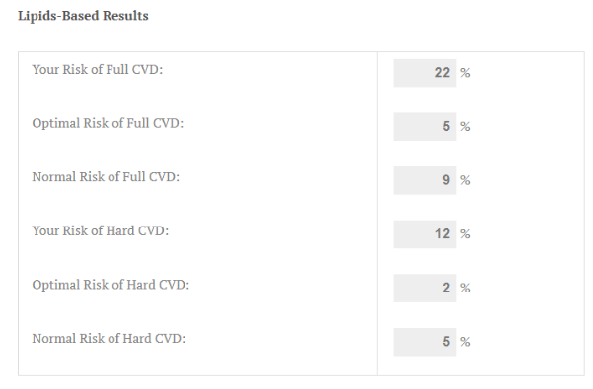
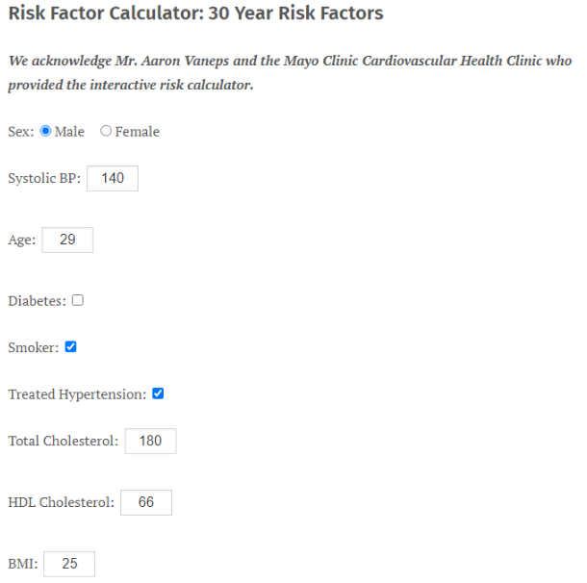
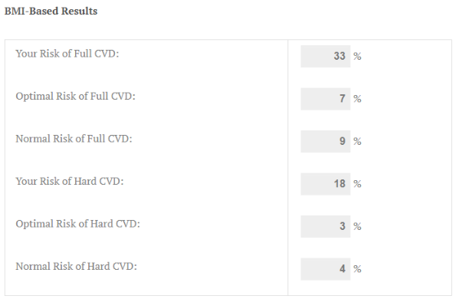
RELATED INDUSTRY
Framingham Heart Study: A long-term, ongoing cardiovascular cohort study that has been a source for various ML projects due to its comprehensive datasets.

Slide 6
PROBLEM
Heart rate and variability are not always linked directly to clinical outcomes.
ECG Analysis by AI is not sufficicent information.
The Framingham Heart Study do not really reflect the global diversity of heart disease risk factors and manifestations.
Some of the data might not adjust with modern lifestyle factors and risks associated with heart diseases todays.

Slide 7






RATIONALE
USE
CREATE
PREDICT
HELP
UCI Heart Disease Data Set
Modern Supervised machine learning
Patient's risk of heart disease
Detect and diagnose heart disease early

Slide 8
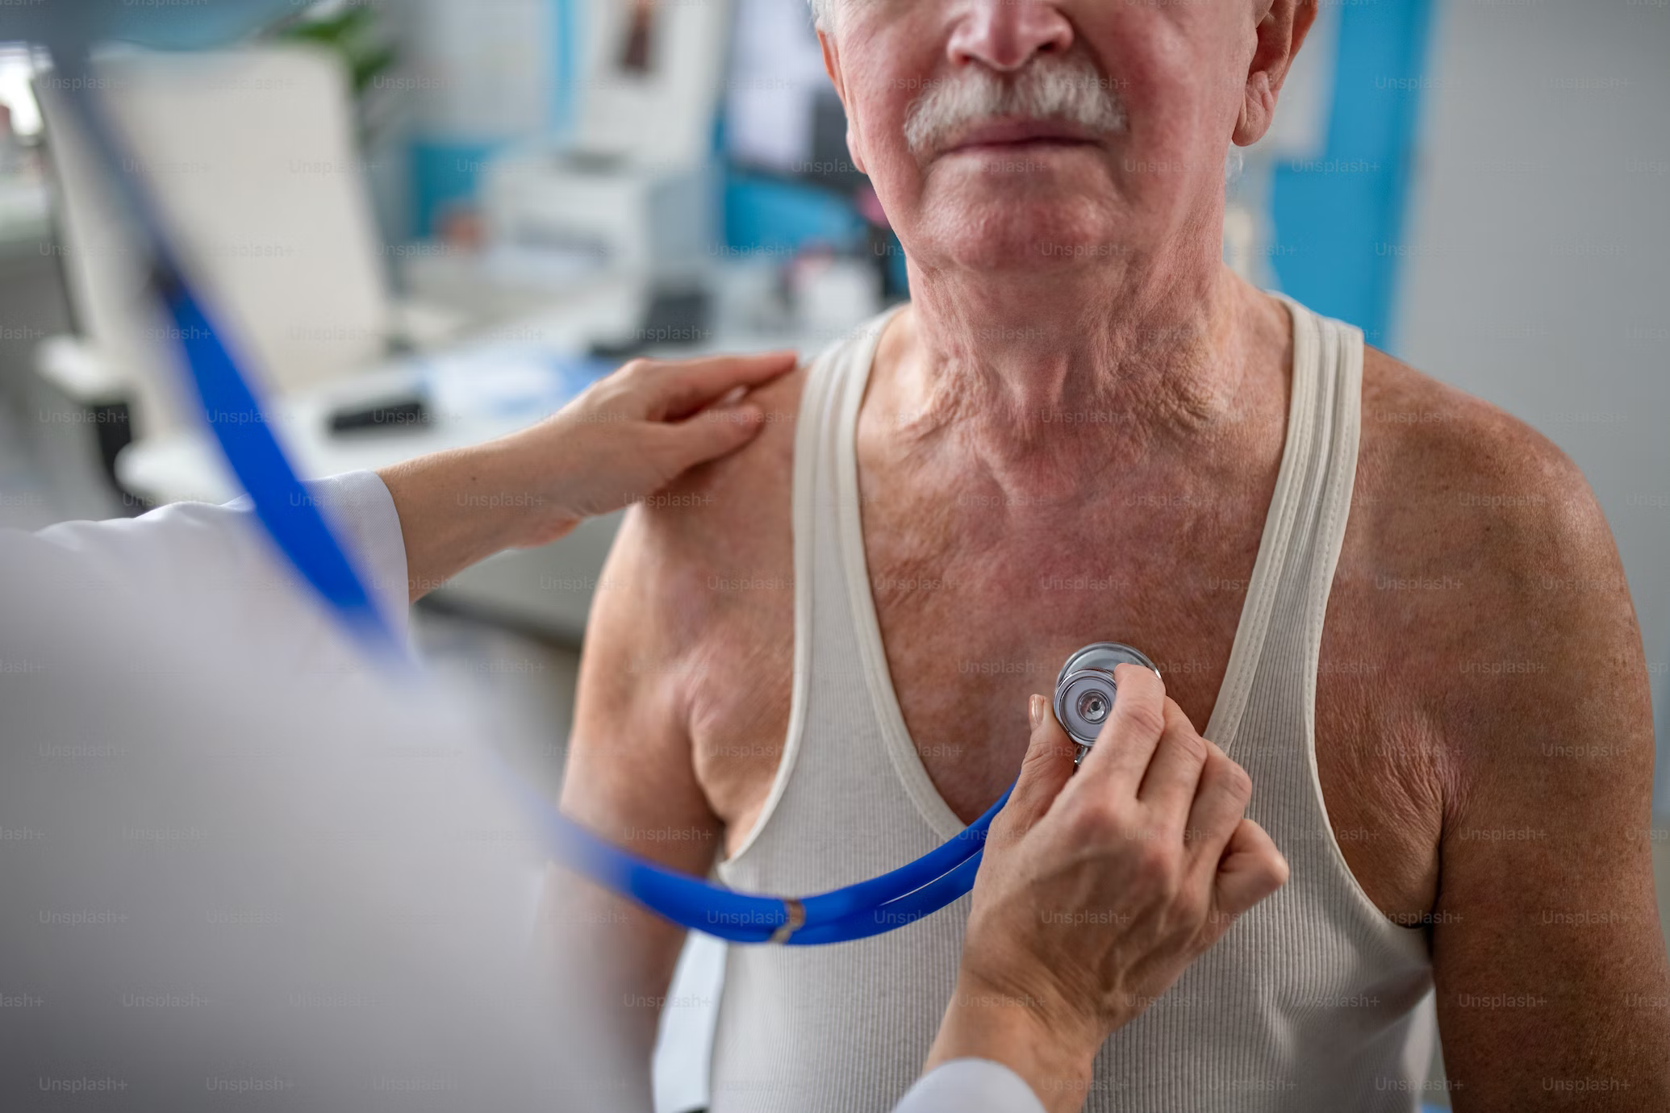




VALUES PROPOSITION
Early Detection
Accuracy Classification
User friendly interface
Data-Driven Insights

Slide 9



TARGET
Patients
Cardiologists and Healthcare Professionals

Slide 10
Requirement Elicitation
To classify the likelihood of heart disease based on a machine learning model.
Add a user-friendly interface for simplicity of usage.
Offer explanations for model predictions.
Update the model frequently to increase precision.

Slide 11
Feasibility
Developing machine learning within a two-month time frame.
The dataset is well-documented and suitable for model training
The availability of machine learning libraries and frameworks simplifies the development process.
Maintaining data privacy and security may require additional time and resources.

Slide 12





RISKS
Data privacy
Ethical Considerations
User Adopter
Data Quality
Model Accuracy

Slide 13

WEBSITE MOCKUPS

Slide 14


Desktop Application

Slide 15
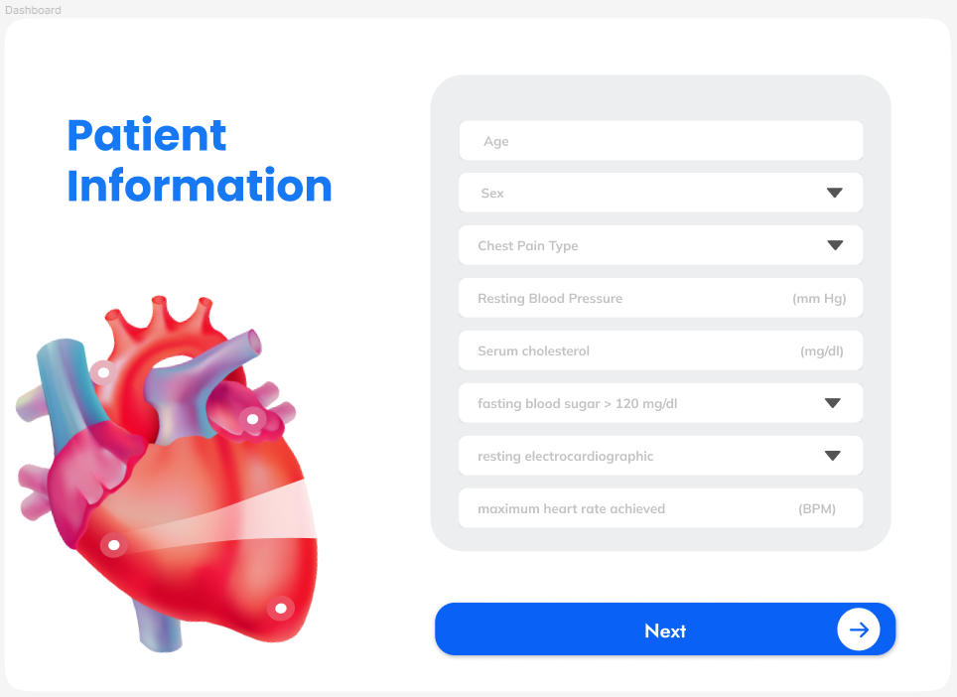
Desktop Application

Slide 16
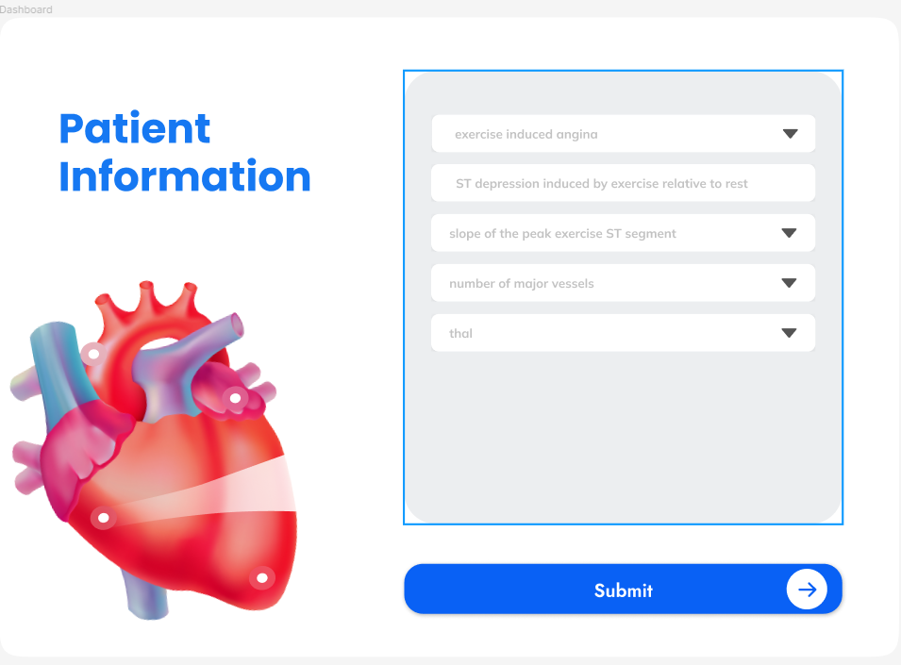
Desktop Application

Slide 17

Desktop Application

Slide 18

Desktop Application

Slide 19
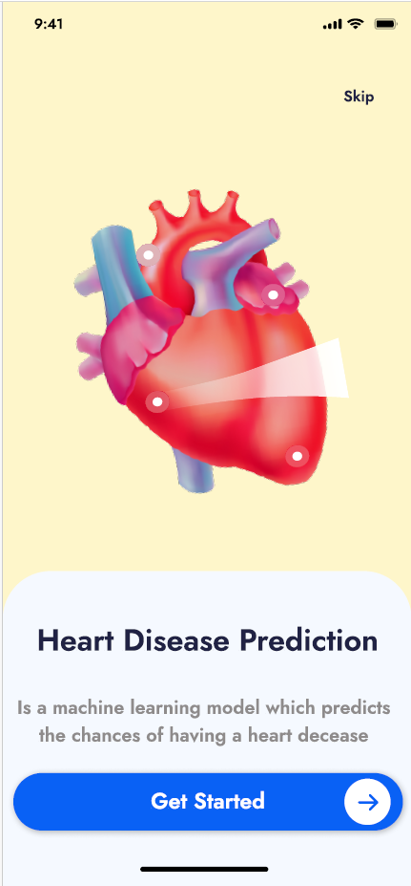
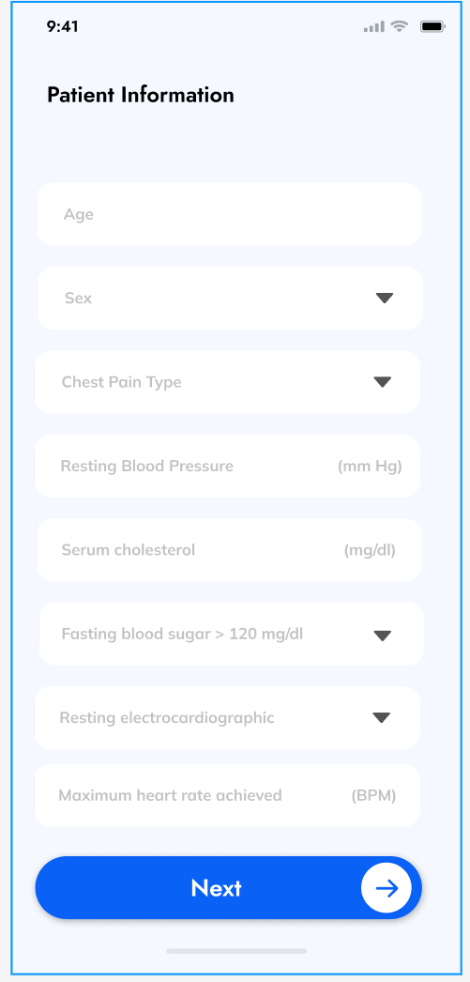
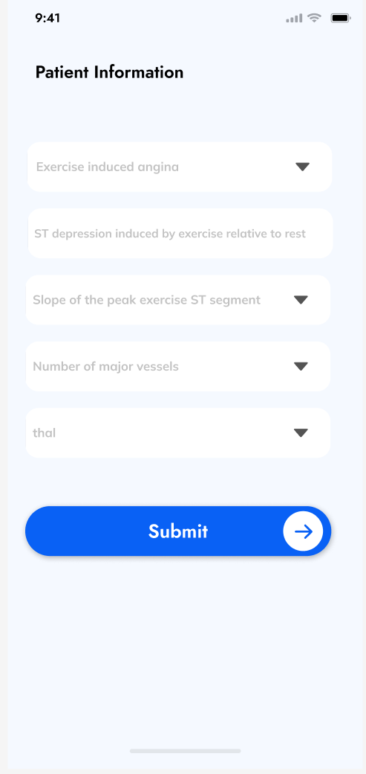
Mobile
Application

Slide 20
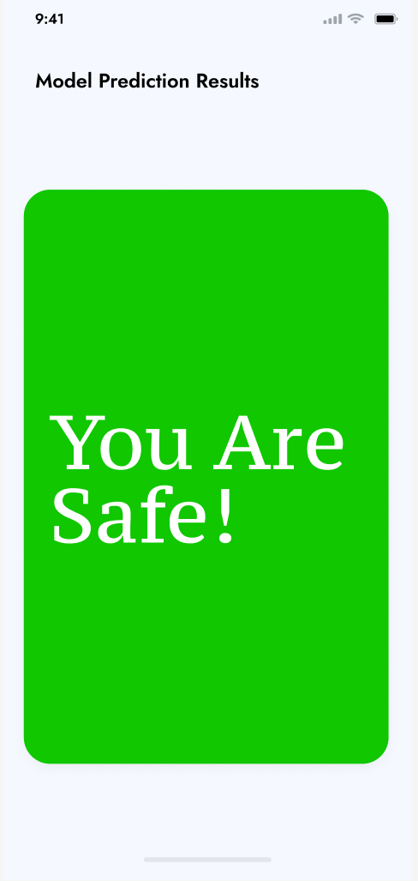
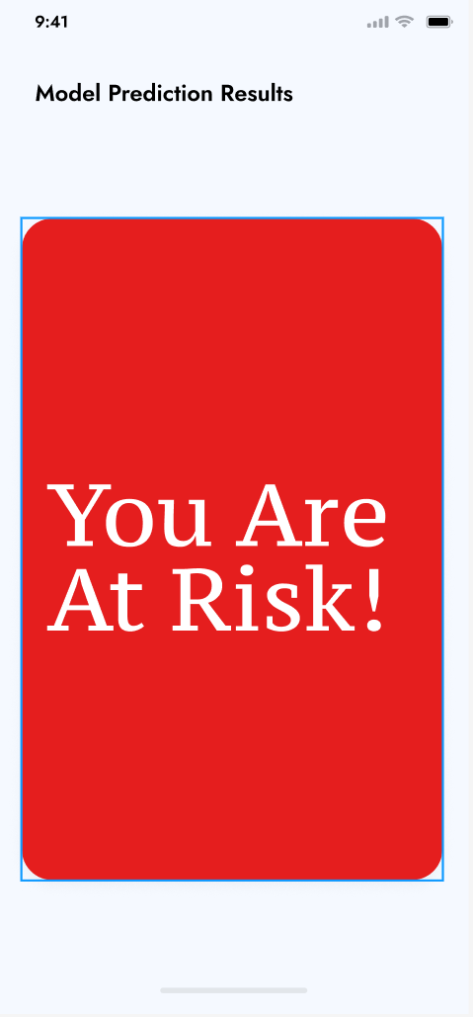
Mobile
Application

Slide 21
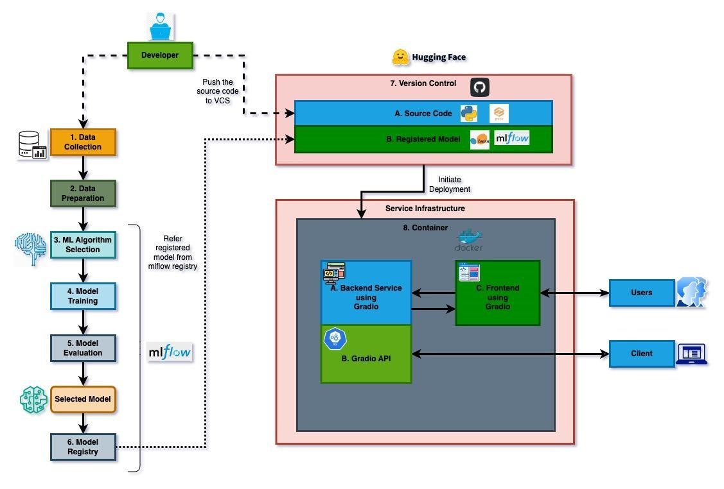



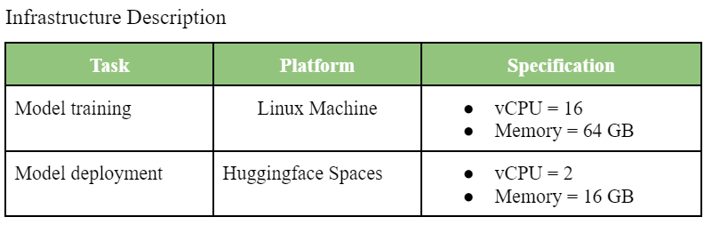
2
DIAGRAMS
1
Training Process
Version Controlling
Deployment Process
3
Process for Heart Disease Stage Prediction ML Model Training and Deployment

Slide 22
TRAINING PROCESS
Use Heart Disease Data Set from UCI data repository
Explore and use into train test split 80:20
Preprocess train and test dataset.
Cross Validation on multiple algorithms(K-fold: 10)
Compare results and select the best performing algorithm
Perform grid search to find the best set of hyperparameters
Train the model using the settings we obtained from the previous steps then compute the performance using the test set
Everything done inside MLFlow environment

Slide 23

VERSION CONTROLLING
Creating a space for deployment in huggingface, a repository is automatically created for version control for both the model & source code of the application. Huggingface space maintains source versioning using the popular VCS git. So, working with HF Space for version control is the same as using github like VCS.

Slide 24

DEPLOYMENT PROCESS
Using Gradio

Slide 25
Gradio
An open-source framework simplifying the creation of machine learning-based applications, requiring minimal GUI development.
Deploying both the backend and frontend elements of these applications.

Slide 26
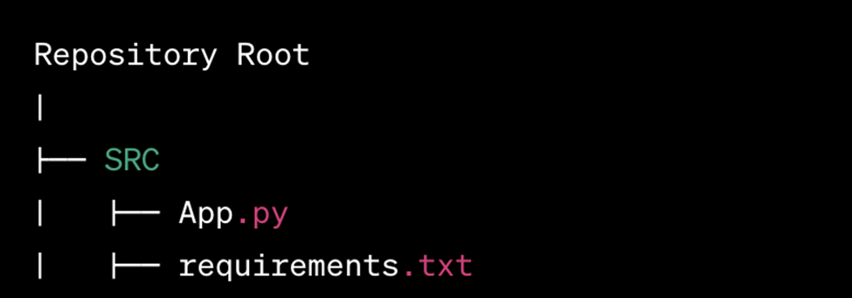
Gradio

Slide 27


Gradio
App.py
Backend
Loads the scikit-learn model from MLflow Model Registry.
Defines the inference function.
Specifies input and output validation rules.
Handles preprocessing and postprocessing of input and output.
Frontend
Defines GUI components using predefined classes.
Renders the web interface using a Gunicorn server.

Slide 28

Gradio
requirements.txt
Including a list of libraries required to run the application, such as scikit-learn, numpy, mlflow and others.
MLflow Model Registry
This is the scikit-learn model that has been trained in the previous steps and registered in the MLflow Model Registry and is prepared for deployment after rigorous testing.

Slide 29


DEPLOYMENT SUMMARY
Docker Image Creation
Image Build Success
Container Initialization
Service Availability
User Interaction
Code Push to VCS

Slide 30
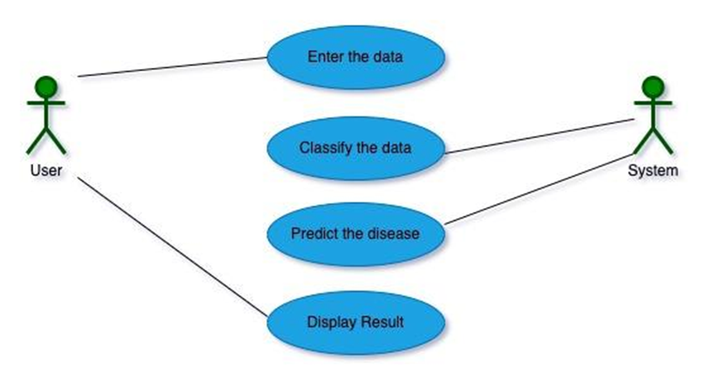
Use Case

Slide 31
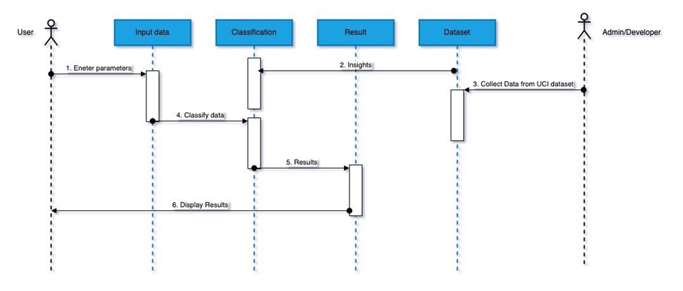
Sequence Diagram

Slide 32
Performance Evaluation
Accuracy
Precision
Recall
F1 Score
Utilized various metrics such as confusion matrices, ROC curves, and precision-recall curves to assess the API's ability to correctly classify.
Emphasizing the reliability and quality of positive predictions by assessing the ratio of accurately identified true positives among all predictions categorized as positive.
Employed sensitivity analysis to determine the API's proficiency in identifying all relevant data in dataset.
Computed a unified metric, considering both precision and recall, to gauge the model's overall performance, particularly important when both precision and recall carry equal importance.

Slide 33


Human Evaluation
Satisfaction of End-Users
Preference and User-Friendliness
Utilized data-driven feedback mechanisms such as surveys and direct interactions to collect comprehensive feedback from end-users and developers, focusing on user experience and practical performance
Employed quantitative analysis to evaluate documentation and integration ease, specifically from a data science perspective. This ensured user-friendliness for data-centric operations and model integrations.

Slide 34

THANKYOU

